Slide 1

Intro to Combinatorial Problems
Haniye Kashgarani
hkashgar@uwyo.edu

Slide 2

Combinatorial Problems
Combinatorial problems involve finding a grouping, ordering, or assignment of a discrete, finite set of objects that satisfies given conditions.
Solutions are candidate solutions that satisfy all given conditions.
Conditions: can be rules or constraints.

Slide 3

Example
Data center resource managements:
The company receives some requested cpus and memories for some computations.
There are bunch of machines with different cpus, memory resource.
We want to assign jobs or services or requests to these machines in a way that optimizes some objectives
Objectives:
smallest number of machines
Constraint:
each service on one machine only
don't exceed memory capacity
don't exceed cpu capacity !

Slide 4
Combinatorial Algorithms
Combinatorial algorithms are ones which deal with a system of discrete objects.
These objects need to be arranged or selected to minimize or maximizing a cost function depending on the problem.
For example: Cost function can be performance of algorithms in terms of runtime.
Mostly, computation behind these algorithms
too difficult
too expensive to compute
faster solutions
number of alternatives to be explored grows very fast with the increase in problem size

Slide 5
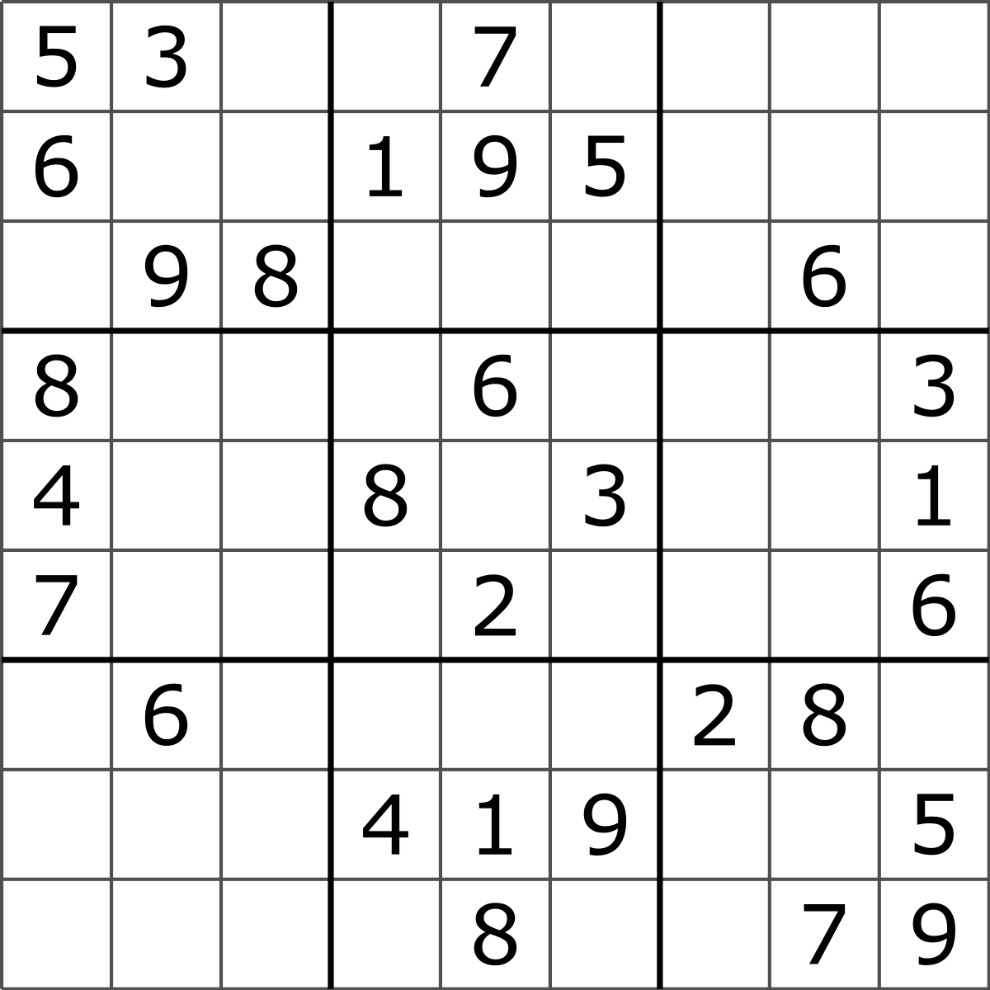
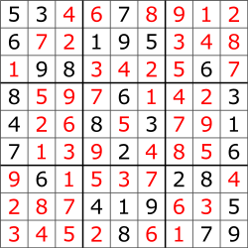
Sudoku
Constraints:
numbers 1-9 exactly once in each row, column, and square.
Constraints: make the search space smaller and make the problem trackable.
Less constraints: we have bigger search spaces for each cell so it will be harder problem to solver the sudoku.
Number of solutions in a sudoku depend on the number of empty cells or the size of the search space; if we have more empty cells or more search spaces, we will have more solutions for a sudoku. There are different ways and algorithms that solve sudokus and based on a cost function we can do optimization!
4,7
3

Slide 6
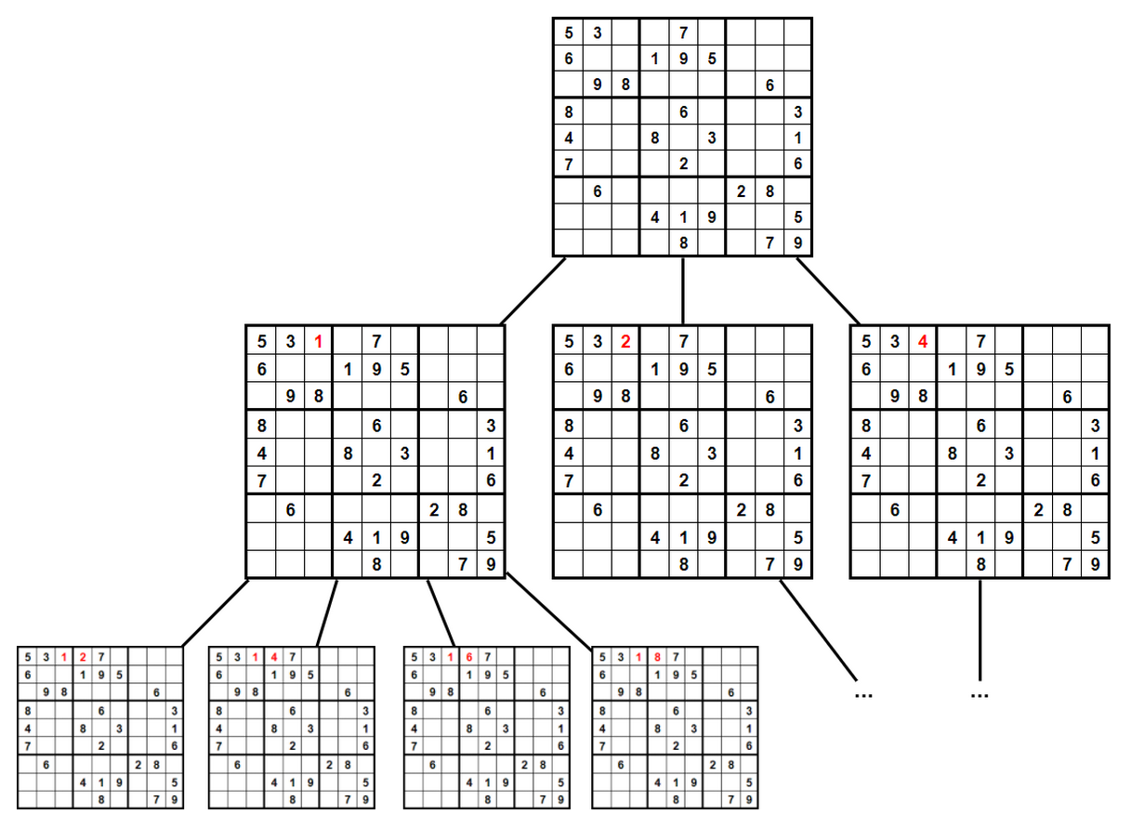
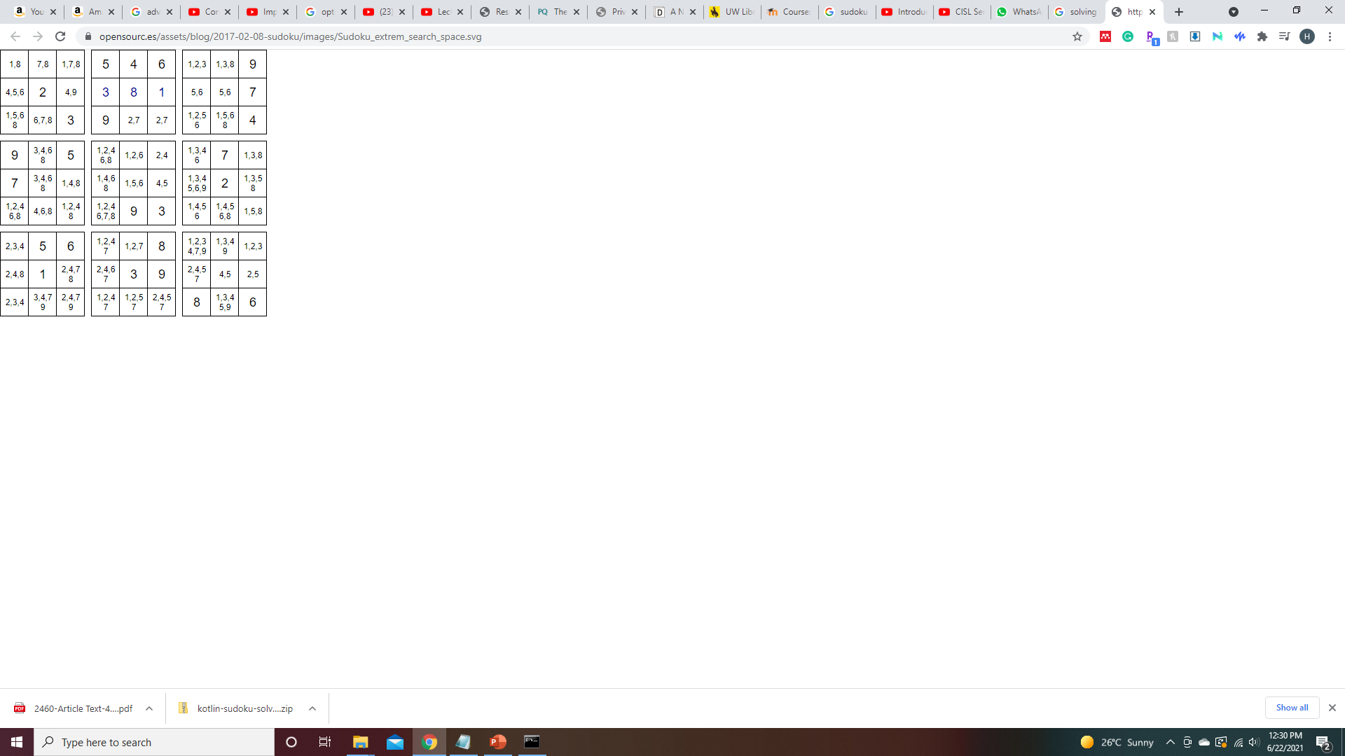
Strategies
Solving Sudoku with Backtracking Solving Sudoku with Constraint Propagation

Slide 7
Combinatorial Optimization
Subset of mathematical optimization that is related to operations research, algorithm theory and computational complexity.
Find the optimal object from finite set of objects in terms of the desired cost function.
Which solution is better using cost function optimization

Slide 8
Solving Combinatorial Problems with ML
Not inventing new algorithms
Using ML techniques
Using the existing algorithms intelligently and automatically.
This can be selection between these algorithms, automatically configurating the algorithms, or ordering the algorithms in a desired order!

Slide 9
Other Popular Combinatorial Problems
Traveling Salesman Problem (TSP)
Boolean Satisfiability (SAT)
Planning
Time-tabling
Some Application Examples:
Optimal way to deliver packages
Scheduling rescue units in response to disasters like earthquakes
Internet data packet routing

Slide 10
References and Additional Resources
http://www.cs.ubc.ca/labs/beta/Courses/CPSC532D-05/Slides/ch1-slides.pdf
https://www.sciencedirect.com/science/article/pii/B9781558608726500184
https://www.youtube.com/watch?v=3z7TlxRA3RE
https://ojs.aaai.org/index.php/aimagazine/article/view/2460
https://www.youtube.com/watch?v=PkLjIvv-H-Q&t=554s
https://www.youtube.com/watch?v=XVLd7hf6y6M&t=0s

